Slide 1
Similarity and Distance
Acknowledge:
Tan, Steinbach, and Kumar, “Introduction to Data Mining”
Rajaraman and Ullman, “Mining Massive Datasets”

Slide 2
Similarity and Distance
For many different problems we need to quantify how close two objects are.
Examples:
For an item bought by a customer, find other similar items
Group together the customers of a site so that similar customers are shown the same ad.
Group together web documents so that you can separate the ones that talk about politics and the ones that talk about sports.
Find all the near-duplicate mirrored web documents.
Find credit card transactions that are very different from previous transactions.
To solve these problems we need a definition of similarity, or distance.
The definition depends on the type of data that we have

Slide 3
Similarity
Numerical measure of how alike two data objects are.
A function that maps pairs of objects to real values
Higher when objects are more alike.
Often falls in the range [0,1], sometimes in [-1,1]
Desirable properties for similarity
s(p, q) = 1 (or maximum similarity) only if p = q. (Identity)
s(p, q) = s(q, p) for all p and q. (Symmetry)

Slide 4
Similarity between sets
Consider the following documents
Which ones are more similar?
How would you quantify their similarity?
apple releases new ipod
apple releases new ipad
new apple pie recipe

Slide 5
Similarity: Intersection
Number of words in common
Sim(D,D) = 3, Sim(D,D) = Sim(D,D) =2
What about this document?
Sim(D,D) = Sim(D,D) = 3
apple releases new ipod
apple releases new ipad
new apple pie recipe
Vefa releases new book with apple pie recipes

Slide 6
Jaccard Similarity
The Jaccard similarity (Jaccard coefficient) of two sets S₁, S₂ is the size of their intersection divided by the size of their union.
JSim (C₁, C₂) = |C₁∩C₂| / |C₁∪C₂|.
Extreme behavior:
Jsim(X,Y) = 1, iff X = Y
Jsim(X,Y) = 0 iff X,Y have no elements in common
JSim is symmetric
3 in intersection.
8 in union.
Jaccard similarity
= 3/8

Slide 7
Jaccard Similarity between sets
The distance for the documents
JSim(D,D) = 3/5 = 0,6
JSim(D,D) = JSim(D,D) = 2/6 = 0,33
JSim(D,D) = JSim(D,D) = 3/9 = 0,33
apple releases new ipod
apple releases new ipad
new apple pie recipe
Vefa releases new book with apple pie recipes

Slide 8
Similarity between vectors
Documents (and sets in general) can also be represented as vectors
document | Apple | Microsoft | Obama | Election
D1 | 10 | 20 | 0 | 0
D2 | 30 | 60 | 0 | 0
D3 | 60 | 30 | 0 | 0
D4 | 0 | 0 | 10 | 20
How do we measure the similarity of two vectors?
We could view them as sets of words. Jaccard Similarity will show that D4 is different form the rest
But all pairs of the other three documents are equally similar
We want to capture how well the two vectors are aligned

Slide 9
Example
document | Apple | Microsoft | Obama | Election
D1 | 10 | 20 | 0 | 0
D2 | 30 | 60 | 0 | 0
D3 | 60 | 30 | 0 | 0
D4 | 0 | 0 | 10 | 20
apple
Documents D1, D2 are in the “same direction”
Document D3 is on the same plane as D1, D2
Document D4 is orthogonal to the rest
microsoft
{Obama, election}

Slide 10
Cosine Similarity
Sim(X,Y) = cos(X,Y)
The cosine of the angle between X and Y
If the vectors are aligned (correlated) angle is zero degrees and cos(X,Y)=1
If the vectors are orthogonal (no common coordinates) angle is 90 degrees and cos(X,Y) = 0
Cosine is commonly used for comparing documents, where we assume that the vectors are normalized by the document length.

Slide 11
Cosine Similarity - math
Most common measure:
Dot product of two vectors:
Cosine Similarity = normalized dot product
the norm of a vector X is:
the cosine similarity is:

Slide 12
Cosine Similarity - math
If d₁ and d₂ are two vectors, then
cos( d₁, d₂ ) = (d₁ • d₂) / ||d₁|| ||d₂|| ,
Example:
d₁ = 3 2 0 5 0 0 0 2 0 0
d₂ = 1 0 0 0 0 0 0 1 0 2
d₁ • d₂= 3*1 + 2*0 + 0*0 + 5*0 + 0*0 + 0*0 + 0*0 + 2*1 + 0*0 + 0*2 = 5
||d₁|| = (3*3+2*2+0*0+5*5+0*0+0*0+0*0+2*2+0*0+0*0)^{0.5} = (42) ^{0.5} = 6.481
||d₂|| = (1*1+0*0+0*0+0*0+0*0+0*0+0*0+1*1+0*0+2*2) ^{0.5} = (6) ^{0.5} = 2.245
cos( d₁, d₂ ) = .314

Slide 13
Example
document | Apple | Microsoft | Obama | Election
D1 | 10 | 20 | 0 | 0
D2 | 30 | 60 | 0 | 0
D3 | 60 | 30 | 0 | 0
D4 | 0 | 0 | 10 | 20
apple
Cos(D1,D2) = 1
Cos (D3,D1) = Cos(D3,D2) = 4/5
Cos(D4,D1) = Cos(D4,D2) = Cos(D4,D3) = 0
microsoft
{Obama, election}

Slide 14
Example: Similarities among Documents
Consider the following document-term matrix
Dot-Product(Doc2,Doc4) = <3,1,4,3,1,2,0,1> * <0,1,0,3,0,0,2,0>
0 + 1 + 0 + 9 + 0 + 0 + 0 + 0 = 10
Norm (Doc2) = SQRT(9+1+16+9+1+4+0+1) = 6.4
Norm (Doc4) = SQRT(0+1+0+9+0+0+4+0) = 3.74
Cosine(Doc2, Doc4) = 10 / (6.4 * 3.74) = 0.42

Slide 15
Distance
Numerical measure of how different two data objects are
A function that maps pairs of objects to real values
Lower when objects are more alike
Higher when two objects are different
Minimum distance is 0, when comparing an object with itself.
Upper limit varies

Slide 16
Distance Metric
A distance function d is a distance metric if it is a function from pairs of objects to real numbers such that:
d(x,y) > 0. (non-negativity)
d(x,y) = 0 iff x = y. (identity)
d(x,y) = d(y,x). (symmetry)
d(x,y) < d(x,z) + d(z,y) (triangle inequality ).

Slide 17
Triangle Inequality
Triangle inequality guarantees that the distance function is well-behaved.
The direct connection is the shortest distance
It is useful also for proving useful properties about the data.

Slide 18
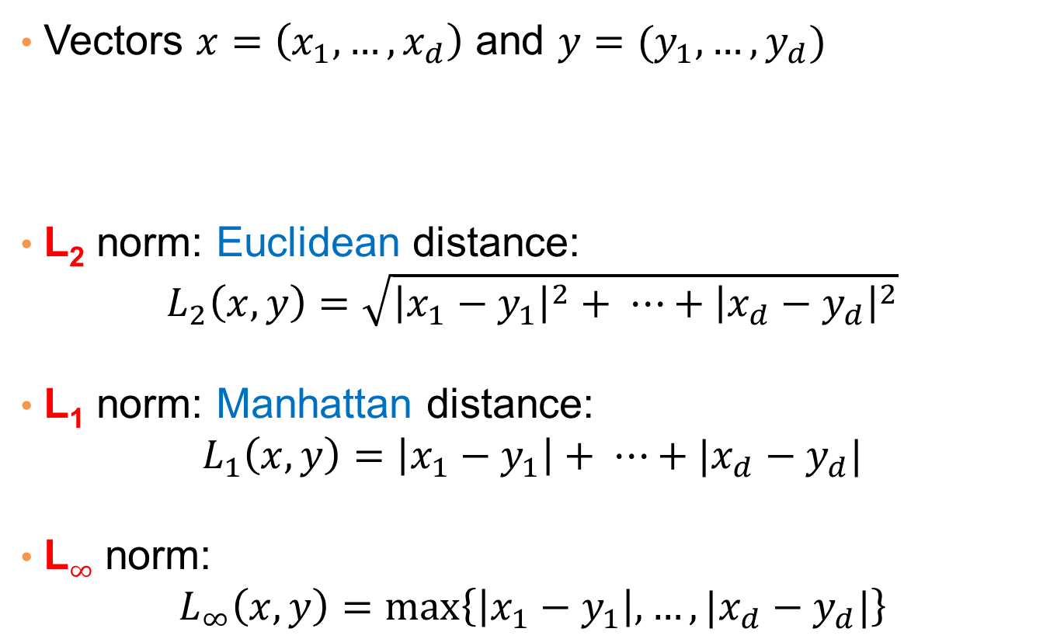
Distances for real vectors
Vectors $x=\left(x_{1},…,x_{d}\right)$ and $y=(y_{1},…,y_{d})$
L₂ norm: Euclidean distance:
$$L_{2}\left(x,y\right)=\sqrt{{\left|x_{1}−y_{1}\right|}^{2}+ ⋯+{\left|x_{d}−y_{d}\right|}^{2}}$$
L₁ norm: Manhattan distance:
$$L_{1}\left(x,y\right)=\left|x_{1}−y_{1}\right|+ ⋯+|x_{d}−y_{d}|$$
L$∞$ norm:
$$L_{∞}\left(x,y\right)=\max\left\{\left|x_{1}−y_{1}\right|,…,|x_{d}−y_{d}|\right\}$$

Slide 19
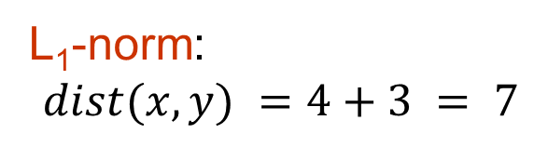
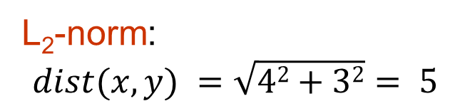
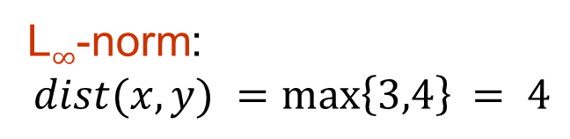
Example of Distances
y = (9,8)
L₂-norm:
$$dist(x,y) =\sqrt{42+32}= 5$$
5
3
L₁-norm:
$$dist(x,y) =4+3 = 7$$
4
x = (5,5)
L$∞$-norm:
$$dist(x,y) =\max\left\{3,4\right\}⁡= 4$$

Slide 20
Example: Data Matrix and Distance Matrix
Data Matrix
Distance Matrix (Manhattan)
Distance Matrix (Euclidean)

Slide 21

Example
r
$$x= (x_{1},…,x_{n})$$
Green: All points y at distance L₁(x,y) = r from point x
Blue: All points y at distance L₂(x,y) = r from point x
Red: All points y at distance L$∞$(x,y) = r from point x

Slide 22
Distance between strings
How do we define similarity between strings?
Important for recognizing and correcting typing errors and analyzing DNA sequences.
weird wierd
intelligent unintelligent
Athena Athina

Slide 23
Edit Distance for strings
The edit distance of two strings is the number of inserts and deletes of characters needed to turn one into the other.
Example: x = abcde ; y = bcduve.
Turn x into y by deleting a, then inserting u and v after d.
Edit distance = 3.
Minimum number of operations can be computed using dynamic programming
Common distance measure for comparing DNA sequences

